Slide 1

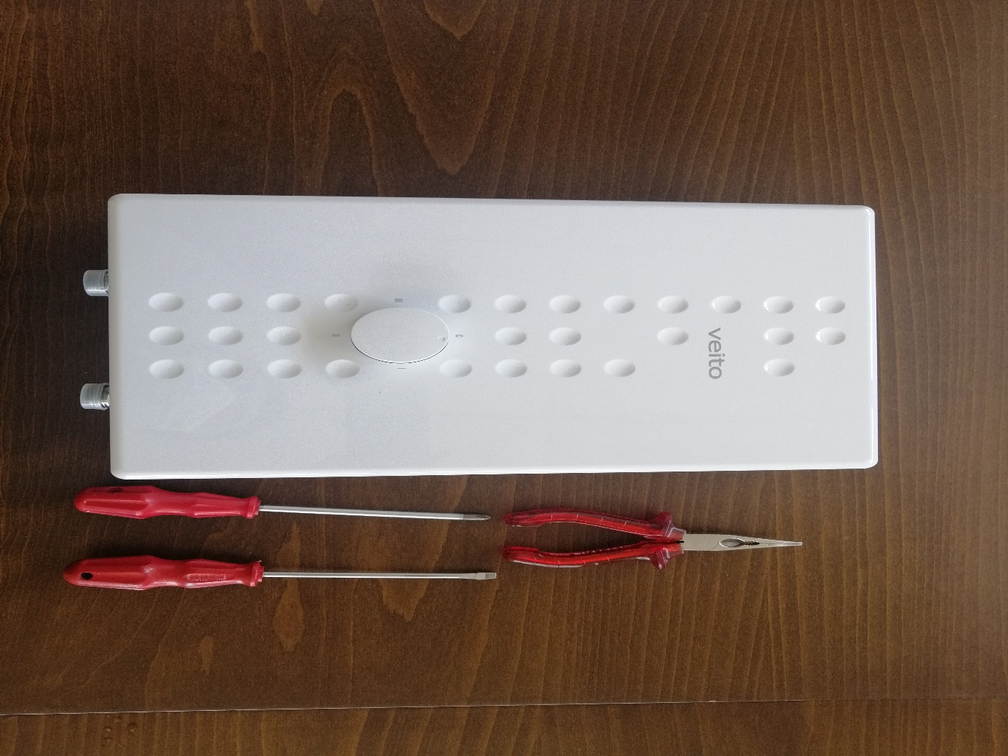
SPEED 7,5/SPEED 9/ SPEED 10,50/ SPEED 12 Regulator Dismantling

Slide 2
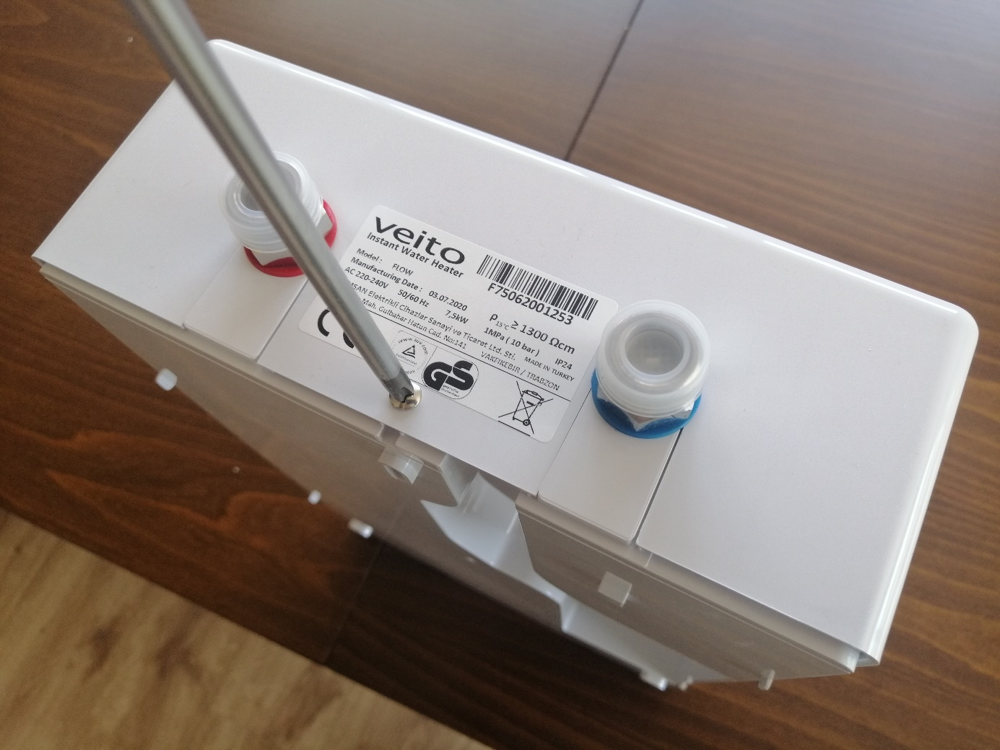
SPEED 7,5/SPEED 9/ SPEED 10,50/
SPEED 12 Regulator Dismantling
Stage 1: Dismount screw shown in figure

Slide 3
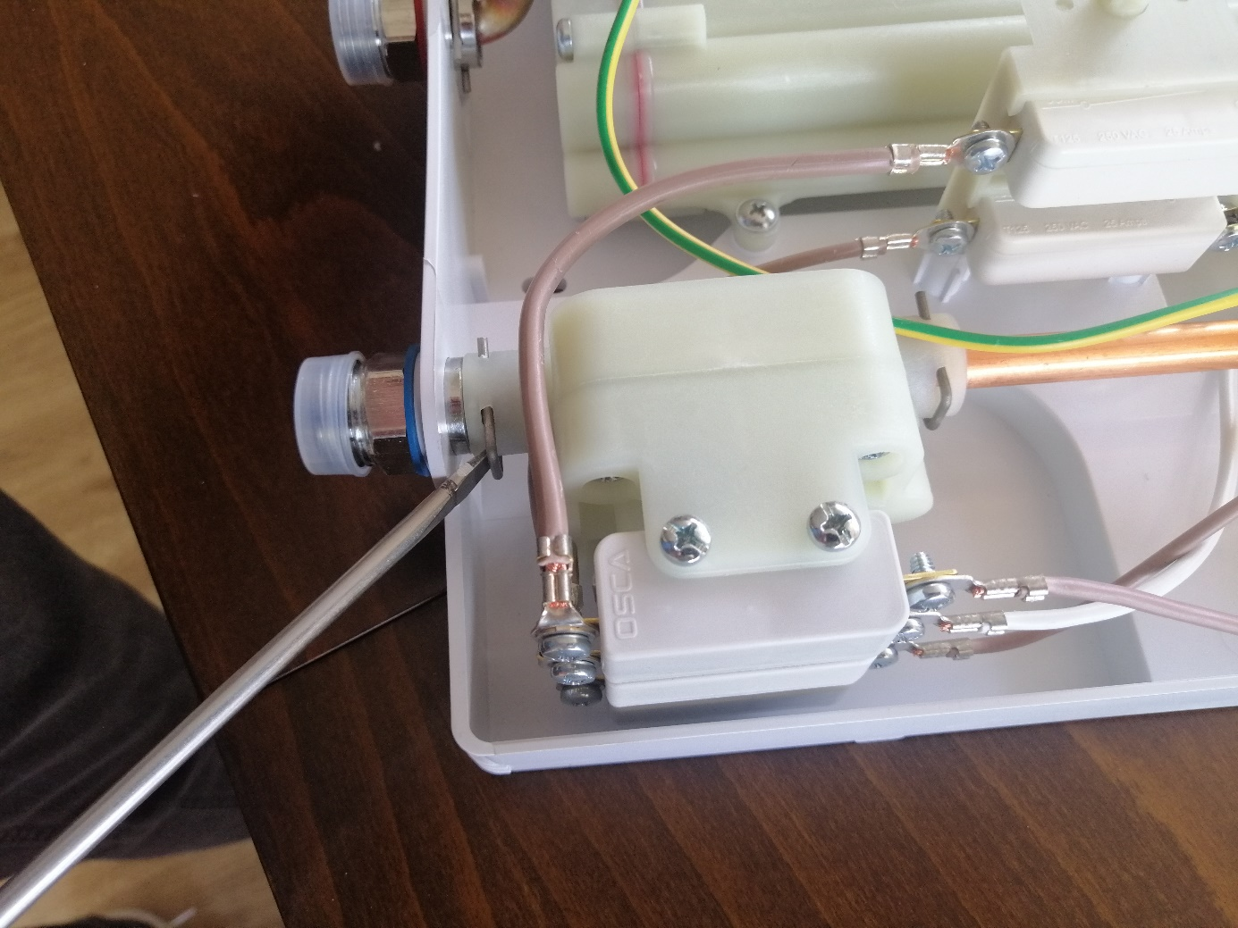
SPEED 7,5/SPEED 9/ SPEED 10,50/
SPEED 12 Flow Regulator Dismantling
Stage 2: Dismount u form piston ring on the water inlet side

Slide 4
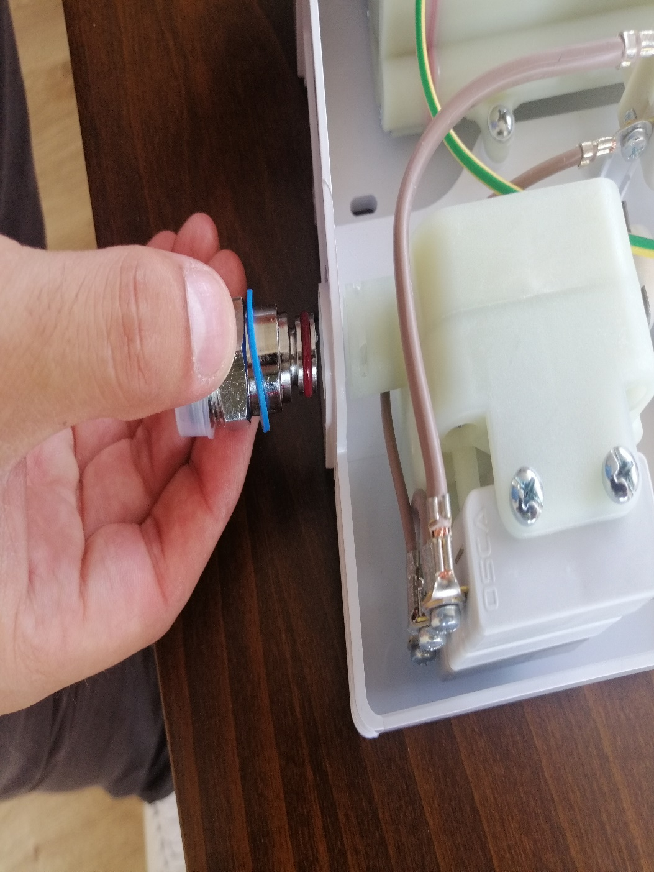
SPEED 7,5/SPEED 9/ SPEED 10,50/
SPEED 12 Regulator Dismantling
Stage 3: take out the water inlet fitting part

Slide 5
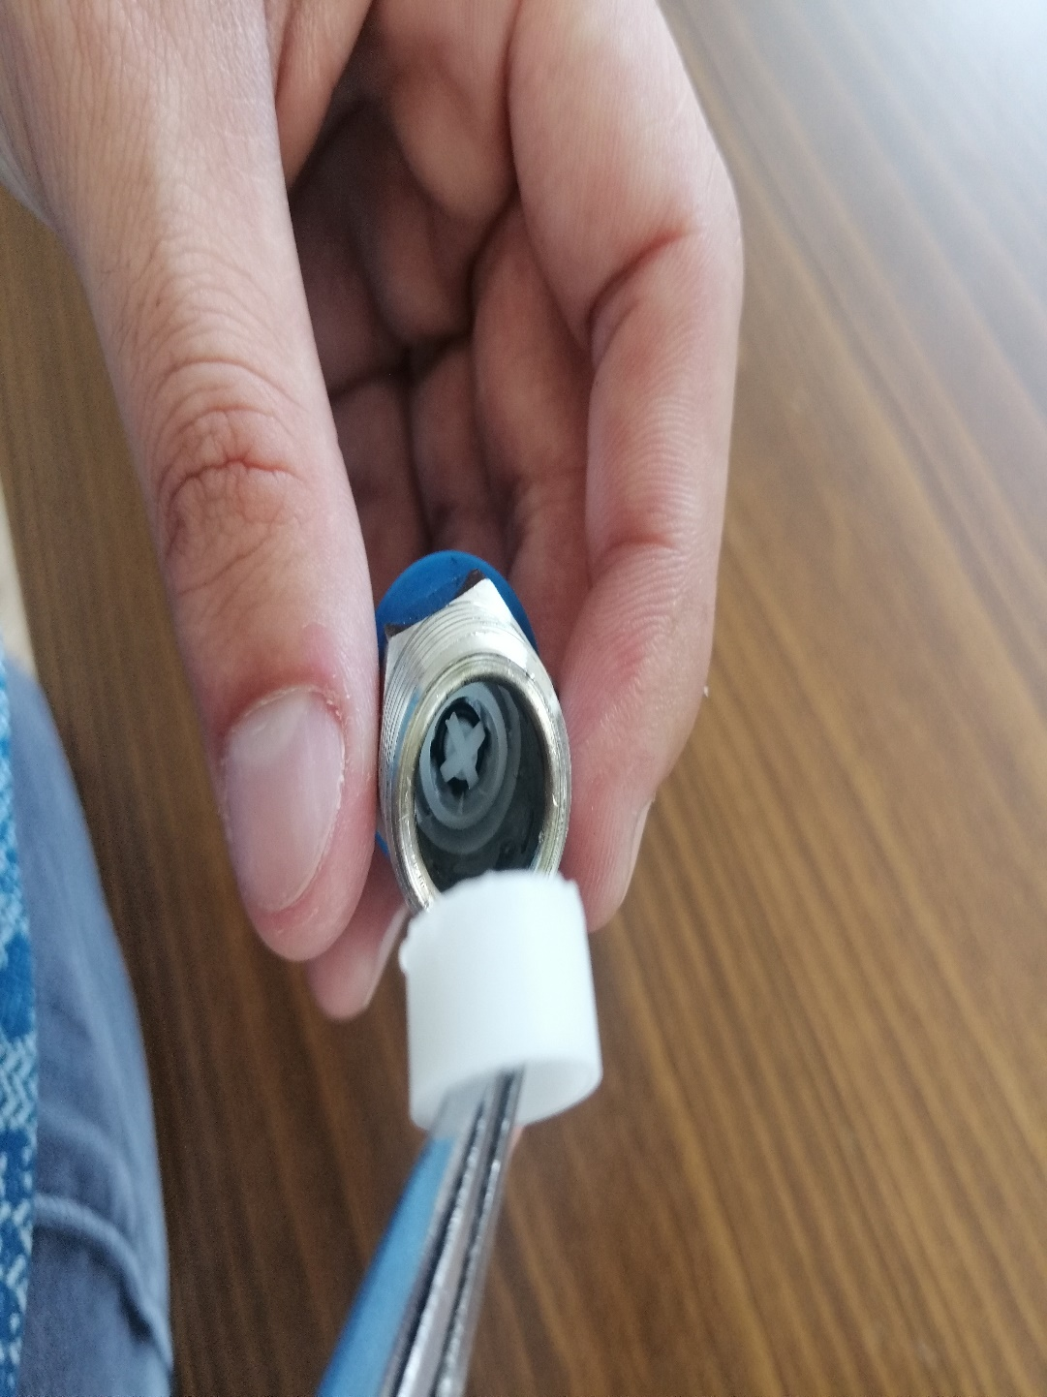
SPEED 7,5/SPEED 9/ SPEED 10,50/
SPEED 12 Regulator Dismantling
Stage 4: take out the filter

Slide 6
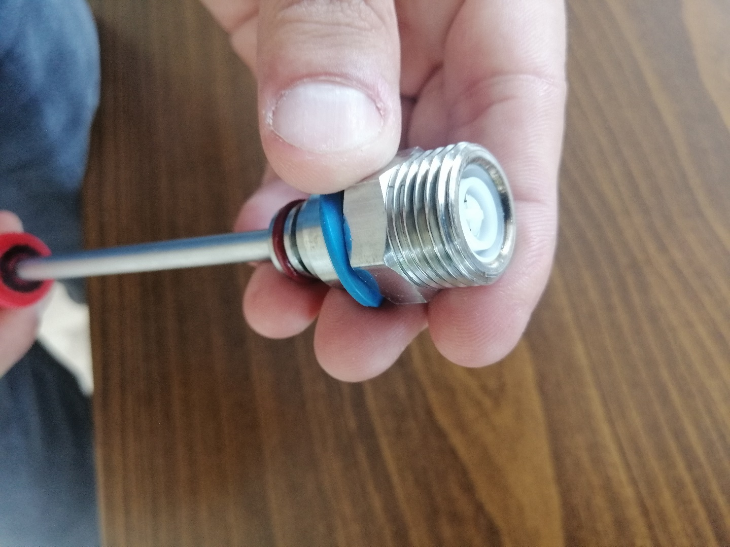
SPEED 7,5/SPEED 9/ SPEED 10,50/
SPEED 12 Regulator Dismantling
Stage 5: push gently flow regulator inside the fitting part and take out

Slide 7
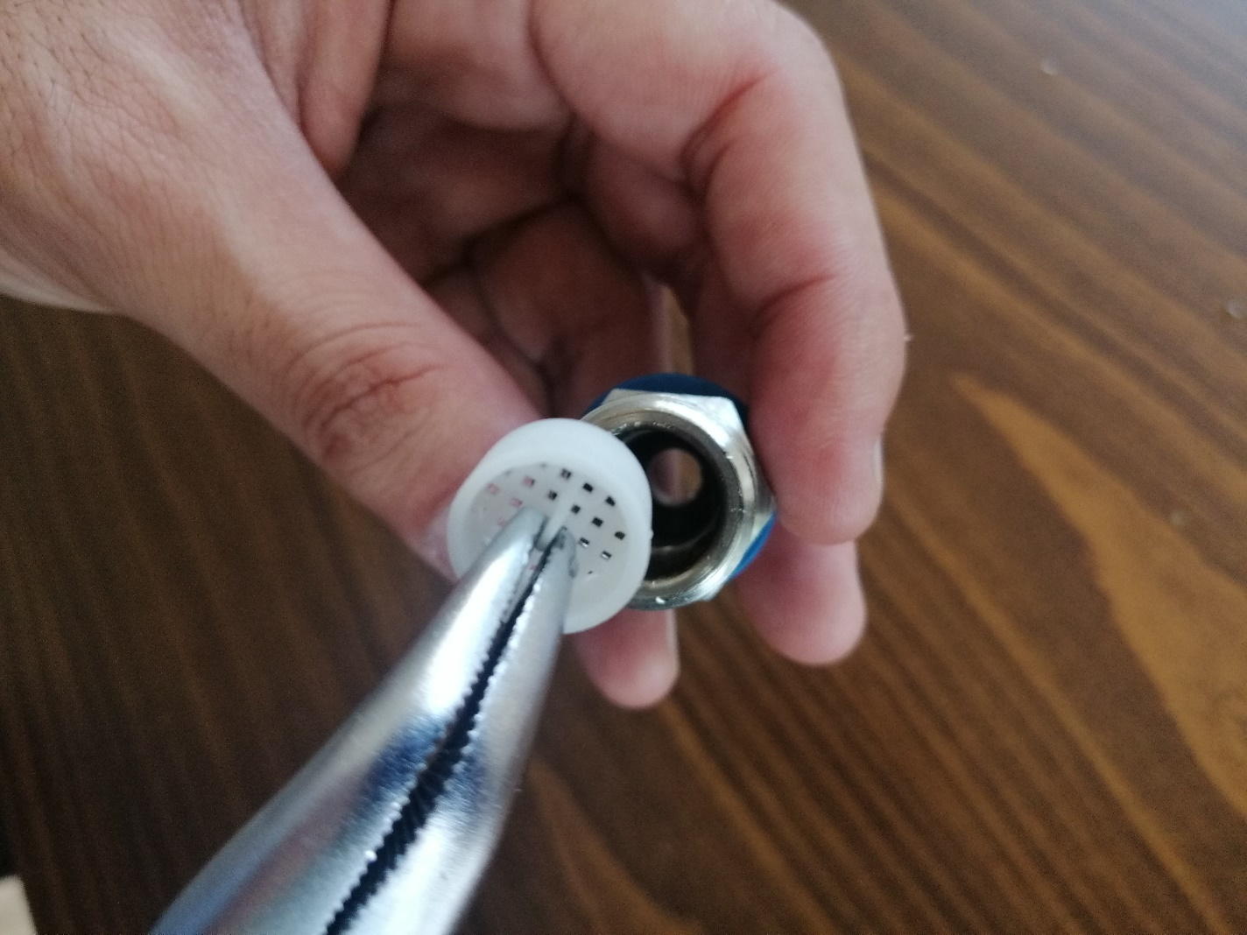
SPEED 7,5/SPEED 9/ SPEED 10,50/
SPEED 12 Regulator Dismantling
Stage 6: insert filter inside of the fitting part
Stage 7: to mounting other parts do steps backward ( step 3-1)

